Slide 1

Assignment 1 Systolic Blood Pressure Prediction
Grace Chan
Po-Chih Kuo

Slide 2
Introduction
Systolic Blood Pressure (SBP) is important in predicting the risk of diseases such as coronary heart disease and congestive heart failure.
Prediction of SBP based on available data can help to monitor one’s blood pressure even without blood pressure monitors and cuffs.
It will also be useful when it comes to filling in missing SBP data in datasets.
Therefore, in this assignment, you are required to use the given dataset and build regression models to predict patient’s SBP based on the available data.

Slide 3
Dataset
Properties of dataset
Real data obtained from hospitals
Multiple patients
Multiple records for each patient
May contain outliers
May contain missing data
Time-dependent data
Temperature
Chart time
Heart rate
Respiratory rate
Oxygen saturation
Diastolic Blood Pressure (DBP)
Systolic Blood Pressure (SBP)

Slide 4
Goal
Predict the SBP of one patient using DBP.
Combine temperature, heart rate, respiratory rate, oxygen saturation, or other variables to predict the SBP of patients.
Implement the regression model to achieve the prediction.
Preprocess/Split the data for model training/validation.

Slide 5
Grading Policy
Item | Score
Basic Implementation | 55%
Advanced Implementation | 40%
Report | 5%

Slide 6
Basic Implementation (55%)
Given the DBP of one patient previously recorded in the hospital.
Build two regression models, one using the Matrix Inversion method and the other using the Gradient Descent method for the patient using DBP as an input variable to predict the patient’s SBP afterward.
Please use the file we provide as your input.
Print the coefficients of your models.
For the Gradient Descent method, output your coefficients for every update step to a csv file

Slide 7
Basic Grading Policy
Matrix Inversion Method – 25%
Mean absolute percentage error (MAPE) <= 10% (20%)
Printing coefficients (5%)
Gradient Descent Method – 30%
MAPE <= 10% (20%)
Output coefficient update in a csv file (5%)
Printing coefficients (5%)

Slide 8

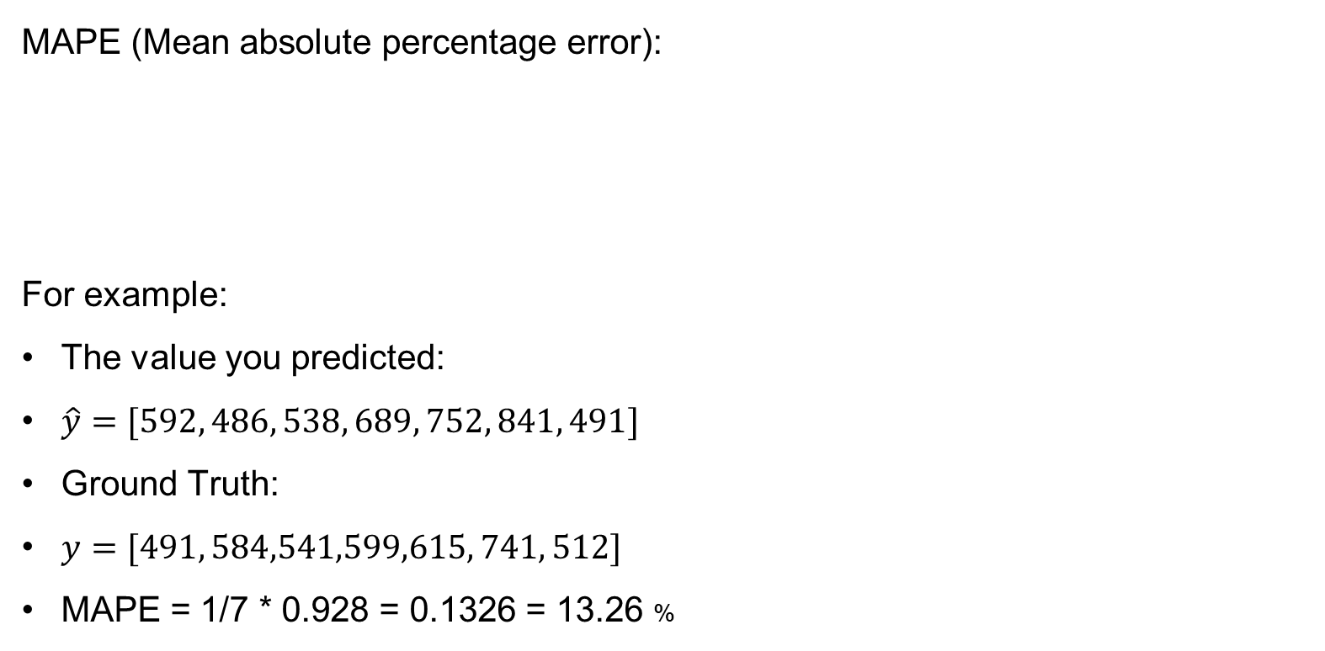
The Evaluation Metric
MAPE (Mean absolute percentage error):
For example:
The value you predicted:
$\hat{y}=[592, 486, 538, 689, 752, 841, 491]$
Ground Truth:
$y=[491, 584,541,599,615, 741, 512]$
MAPE = 1/7 * 0.928 = 0.1326 = 13.26 %

Slide 9
Possible ways to improve your model
There will be outliers among the training data. You can try to deal with them before training your model.
If you use any other methods, please put them in your report.
** Don’t worry, there won’t be outliers in the testing data

Slide 10
Advanced Implementation (40%)
Given previously recorded datasets with multiple variables (temperature, heartrate …) to predict the SBP for multiple patients.
You can use either Matrix Inversion or Gradient Descent for this part.
Using only one variable (same approach as the basic part) will not get points.

Slide 11
Advanced Grading Policy
Baseline – 30%
Average MAPE of all patients <= 15%
Ranking – 10%
Compete your average MAPE with the whole class
**Only those who pass the baseline will enter the ranking part

Slide 12
Possible ways to improve your model
The dataset consists of outliers and missing data, you can consider filling in or removing these data.
Instead of only training one model with all patient’s data, you can try to separate the training data and train a model specifically for each patient.
You can also consider the chart time (autoregression).
You can try to use different kernel to see which one works best.

Slide 13
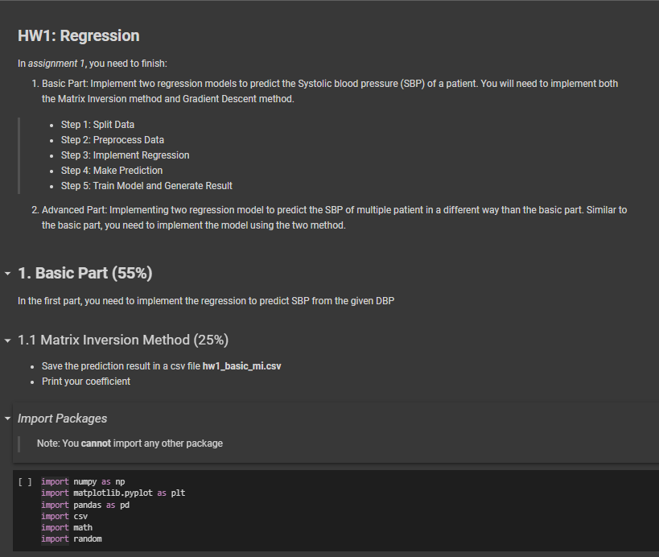
Template
You must use the given file “hw1_template.ipynb” to build the model
Except for the imported packages in the template, you cannot use any other packages for both basic and advanced part

Slide 14
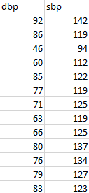
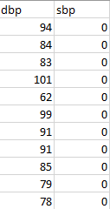
Basic Input File Format
hw1_basic_training.csv
There will be two input files:
“hw1_basic_training.csv”
Each row has DBP and SBP.
Contains 373+1 rows
“hw1_basic_testing.csv”
SBPs to be predicted are filled with 0
Contains 20+1 rows
Make sure your model can read this format as input
hw1_basic_testing.csv

Slide 15
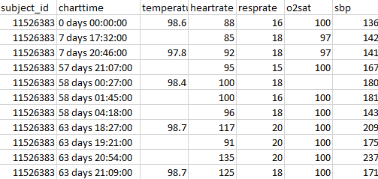
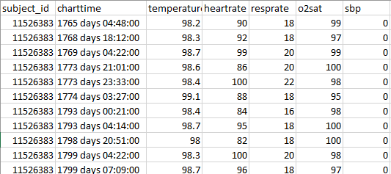
Advanced Input File Format
hw1_advanced_training.csv
There will be two input files:
“hw1_advanced_training.csv”
Each row has “subject ID, chart time, temperature, heart rate, respiratory rate, oxygen saturation, and SBP”
Contains a (5696 +1) * 7 matrix
“hw1_ advanced _testing.csv”
SBPs to be predicted are filled with 0
Contains (220+1) rows
Contains 11 patients (20 testing data each)
Make sure your model can read this format as input
hw1_advanced_testing.csv

Slide 16

Prediction Output File Format
The prediction of both basic and advanced you turned in must follow this format
Basic Part
Matrix Inversion: “hw1_basic_mi.csv”
Gradient Descent: “hw1_basic_gd.csv”
Advanced Part
“hw1_advanced.csv”
Each row represents “SBP” without the header
Make sure your output sequence is correct
Notes:
Only 1 column

Slide 17

Coefficient Update Output File Format
For the Gradient Descent method in both basic part, you will need to output your coefficients of each update to “hw1_basic_coefficient.csv”
Each row represents “w₀, w₁…, w_{n}” without the header, where n is the number of coefficient you used
The number of columns depends on the number of coefficient you used
The number of rows depends on how many iterations you used to update the coefficients
This is an example of the output if you have 2 coefficient and only 4 iterations

Slide 18
Report
Named as “hw1_report.pdf”
Write down your regression equation in the basic part (1%)
Briefly describe the variables you used in the advanced part (1%)
No point would be given for the advanced part if you do not clearly point out the difference between the basic part and the advanced part
Briefly describe the difficulty you encountered (1%)
Summarize how you solve the difficulty and your reflections (2%)
No more than one page

Slide 19
Assignment 1 Requirement
Do it individually! Not as a team!
Announce date: 2023 Sep. 26
Deadline: 2023 Oct. 10 23:59 (Late submission is not allowed!)
Hand in your files in the following format (Do not compress them!)
hw1_basic_mi.csv
hw1_basic_gd.csv
hw1_basic_coefficient.csv
hw1_advanced.csv
hw1.ipynb
hw1_report.pdf

Slide 20
Penalty
0 points if any of the following conditions happened
Plagiarism
Late submission
Not using a template or importing any other packages
Incorrect prediction format
Incorrect submission format

Slide 21
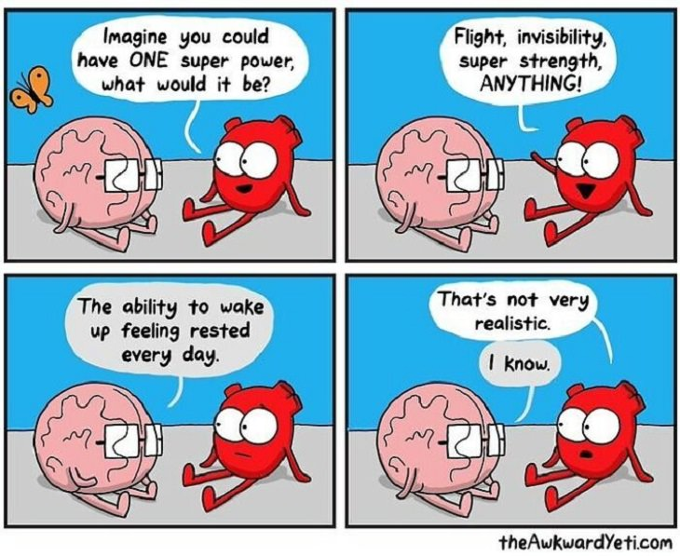
Questions?
TA: Grace Chan (gracechan668@gmail.com)
Do not ask for debugging.
Good luck and have fun!

